Slide 1


MARKET SEGMENTATION
ONLINE RETAIL SHOP
Ashwin Kulangara Shaji
PIN: 93692

Slide 2
OBJECTIVE
Market segmentation data analysis is to create detailed customer groups that have similar personas and purchasing behaviors, treating each type of relationship with the exact attention and action needed to promote growth of company's advertising and marketing efforts for the coming year.
Total Items
Total Customer
Total Country
Total Transaction
4223
4372
37
$1.4 M

Slide 3
WHAT WE CAN IMPROVE
Identify high value customers
Provide relevant offers
01
Build brand loyalty and drive loyal behavior
Deliver more value to your customers
Improve customer retention
02
Understand and design the customer journey
03
Meet customers at their interest level

Slide 4

OUR SOLUTION METHOD
01
02
03
RECENCY
FREQUENCY
MONETARY
Number of days since last purchase
Number of transaction
Total amount of transaction

Slide 5
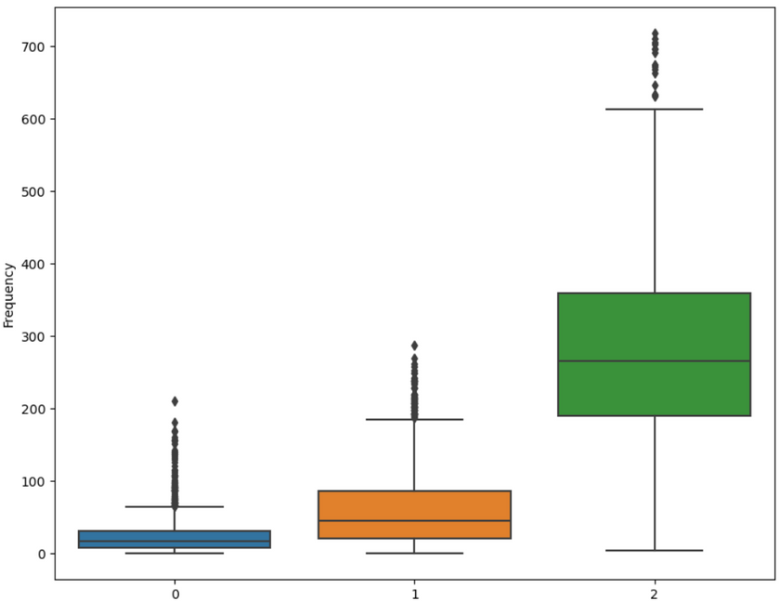
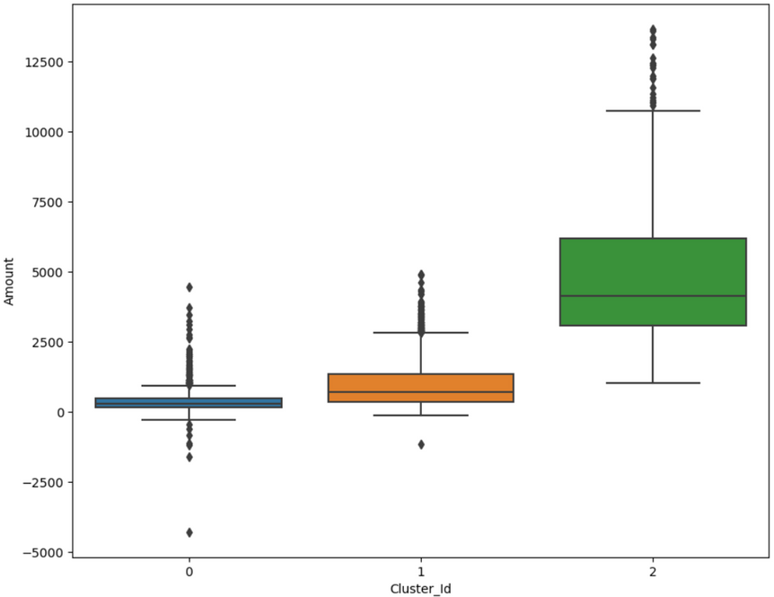
K-MEAN CLUSTERING
Cluster ID vs Frequency
Cluster ID vs Amount
More frequency = less recency

Slide 6



CUSTOMER PERCENTAGE
24.88%
11.62%
63.5%
Cluster 0
Cluster 1
Cluster 2
Frequency
Amount

Slide 7
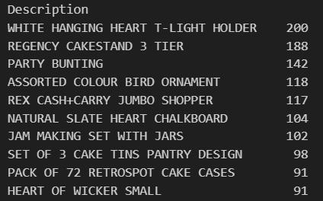
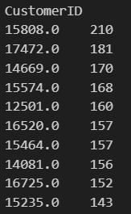
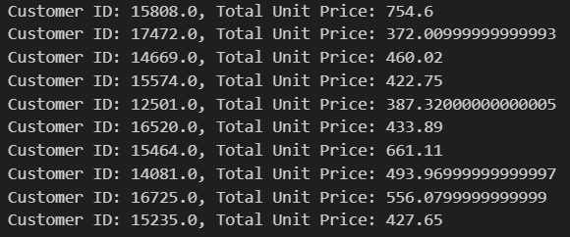
CLUSTER 0
Total Items
Total Customer
Total Country
Total Transaction Amount
2841
1068
28
$145,800

Slide 8
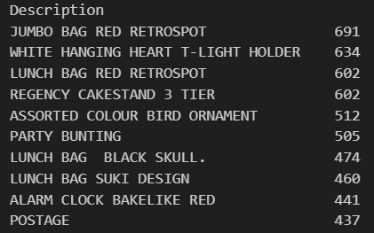
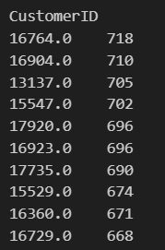
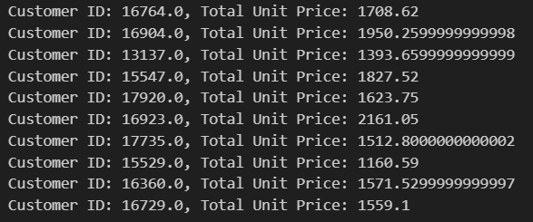
CLUSTER 1
Total Items
Total Customer
Total Country
Total Transaction Amount
3493
499
20
$473,901

Slide 9
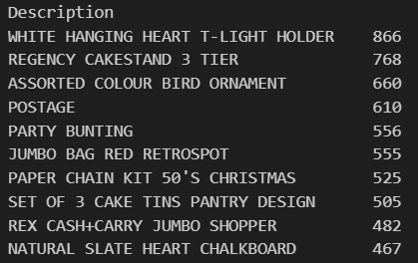
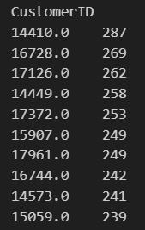
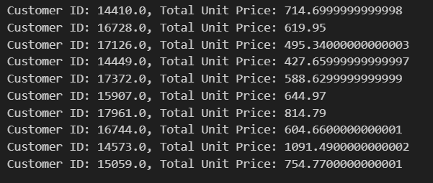
CLUSTER 2
Total Items
Total Customer
Total Country
Total Transaction Amount
3582
2726
29
$509,386

Slide 10
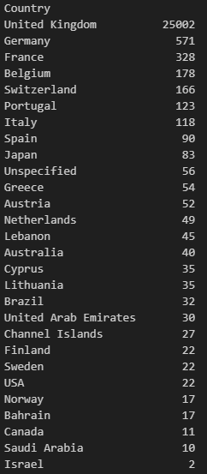
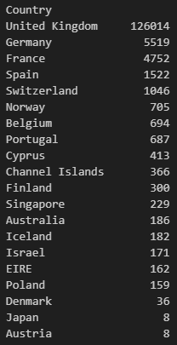
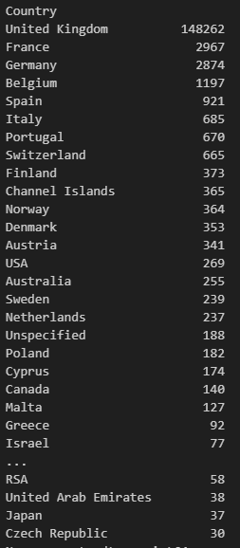
COUNTRY
Cluster 0
Cluster 1
Cluster 2

Slide 11
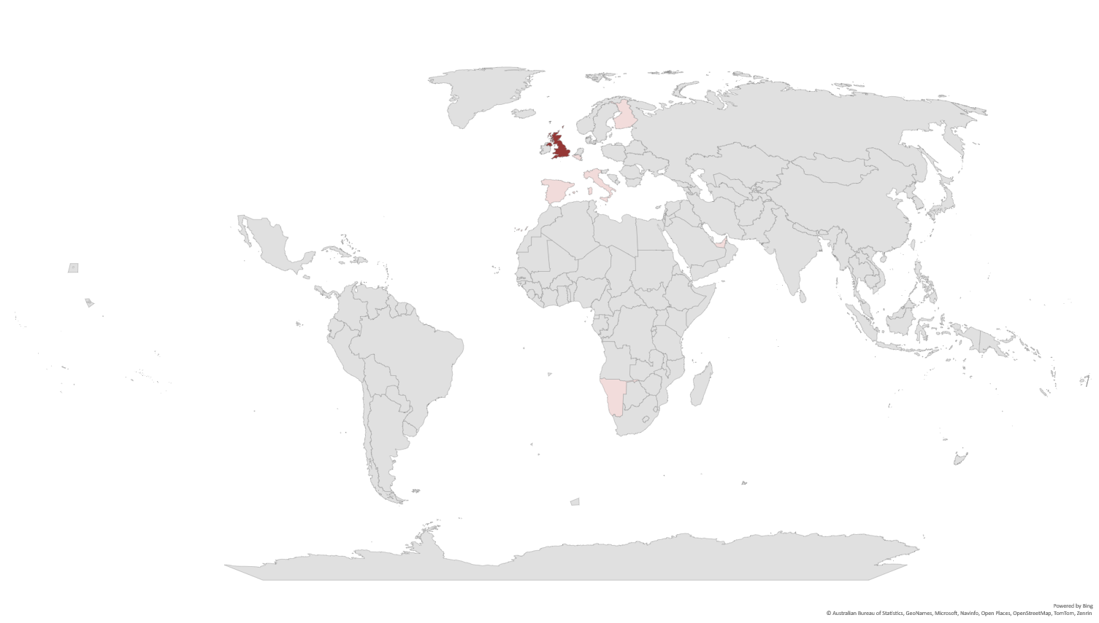
COUNTRY

Slide 12
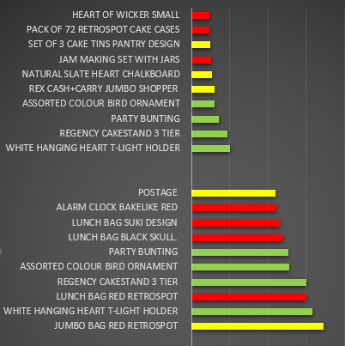
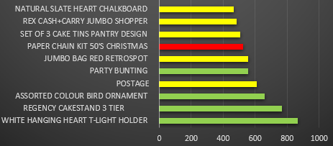

DESCRIPTION ANALYSIS
Cluster 0
Cluster 2
Cluster 1

Slide 13
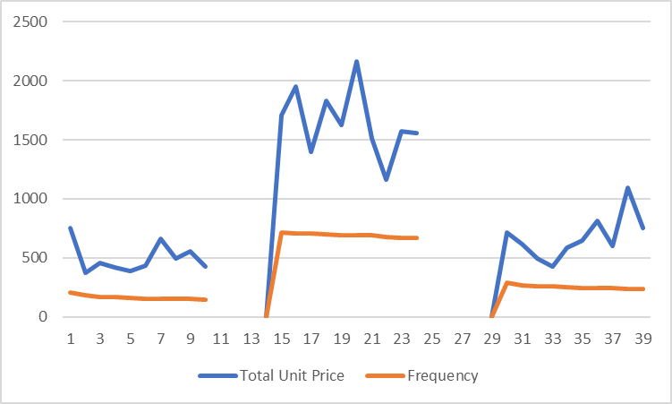

DATA ANALYSIS
Cluster 1
Cluster 2
Cluster 0

Slide 14
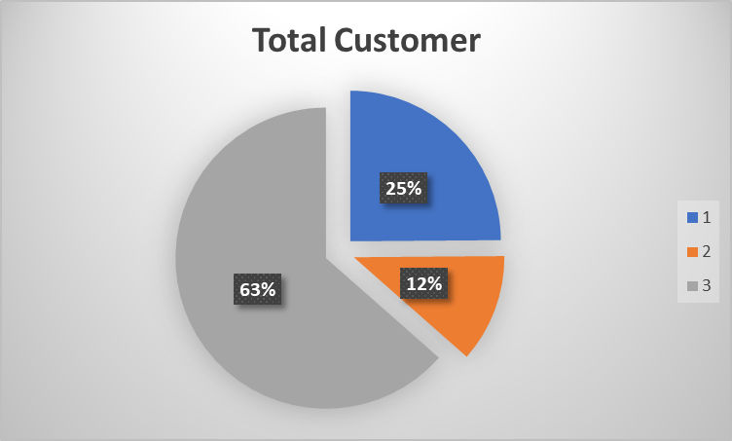
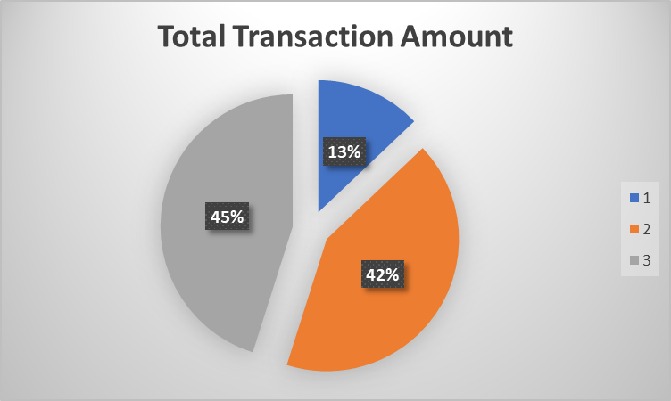

DATA ANALYSIS
Cluster 0
Cluster 0
Cluster 1
Cluster 2
Cluster 2
Cluster 1

Slide 15

FINDINGS
Cluster 1 is the most reliable group
Cluster 2 should be carefully retained
Cluster 1 and 2 are high priority customers
Cluster 0 are depended on offers and are seasonal buyers, least priority

Slide 16
247ERICPOINTCOM
CONTACT US
Address
Number
E-mail
Site Link
Cape Town, Observatory 29 Rochester Road
+ 27 (0) 81 515 22 54
247ericpointcom@gmail
www.247ericpointcom.co.za

